Slide 2
Operations Overview
Ignite World Wide Tour
Microsoft Corporation

Slide 3
Agenda
Unified Logging Service (ULS)
Usage Logging
Health Reports
SharePoint Health Analyzer
Developer Dashboard
Password Management
PowerShell
Appendix
Patching
Business Continuity Management

Slide 4
Unified Logging Service

Slide 5
Overview
Trace logging allows you to log to a text file on the server
Trace logs include more detailed debugging information that isn’t needed by operations
ULS Monitor monitors trace output and fires events when configured thresholds are exceeded
Adjust throttling on a per-category basis to get more detail when troubleshooting an issue

Slide 6
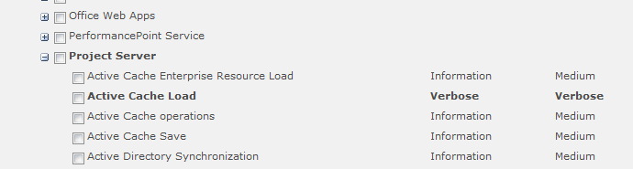
Event Throttling
Re-organized tracing areas or categories for diagnostic trace logging
Non-default configurations will be highlighted in bold to help ITPro notice them
Notes:
Event Throttling is new concept to Microsoft Project Server 2010. In previous versions Diagnostic Logging was leveraged by selecting a tracing area and configuring the tracing level (I.e. Medium, Verbose, Critical, etc.). In Microsoft Project Server2010 the tracing areas have been restructured into categories and within each category a more granular representation of its dependencies, for example Office Server is a category and within Office Server, its individual dependencies.
Tracing areas, or categories have additionally been renamed to align more appropriately for the events which they represent. For example, in Microsoft Office SharePoint Server 2007 General/Administration was a tracing area; however, was largely difficult to understand what was included in this area. The changes in naming convention enable administrators to quickly and efficiently identify events as they occur and are written to the log.
A category when configured outside of its threshold will represent the configuration in bold. For example, Office Server | Audit is configured out of the box with a default level of Medium, when configured to Verbose, this will be represented in bold font to enable an administrator to quickly identify configurations that deviate from their default values.

Slide 7

Event Log Flood Protection
Prevents unmanaged growth of the log
Implements locking to prevent “spam”
If Event x occurs 5x in 120 seconds, prevent Event logging
Notes:
Event Logging Flood Protection helps to prevent unmanaged growth of the log by applying logic in that if the same event ID and category are logged 5 times in 2 minutes (the exception itself does not have to be the same), we will prevent that item from being logged until for 2 minutes.
In Microsoft SharePoint Server 2010 ULS events of level Exception, Assert, or Critical are inserted in the logging database. The logging database is leveraged by the SCOM Management Pack for ULS data so that it can surface those information within SCOM.

Slide 8
Event Log Flood Protection Configuration
Configuration Settings
Setting | Description | Unit | Old Default | New Default
Threshold | The number of events allowed in a given timeframe (TriggerPeriod) until this event is considered to be flooding the log. | Integer. Value must be between 0 (disabled) and 100 (maximum threshold) | 5 | 5
TriggerPeriod | The timeframe to monitor for each event that potentially floods the log. | Seconds | 120 | 120
QuietPeriod | How much time should pass without the event firing to cancel the flooding mode. | Seconds | 30 | 120
NotifyPeriod | If the event is flooding the log for a long time, this setting forces the suppressed notification event to be fired even if the flooding is still occurring. | Seconds | 100 | 300

Slide 9

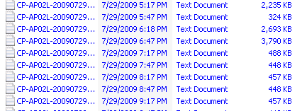
Capacity Planning
Event Log Flood Protection (see previous)
Cleanup
Compression
Quotas
Notes:
ULS logs in Microsoft Office SharePoint Server 2007 could potentially grow at an alarming rate, this was due to difficulty understanding trace areas, the overall number of generated events, quotas, etc. In Microsoft SharePoint Server 2010 several mechanisms have been introduced to provide more efficient capacity management as related to ULS logs including Event Log Flood Protection, cleanup of noise, in addition to leveraging NTFS compression. These steps combined have resulted in an approximately 50% reduction in size of the ULS logs.

Slide 10
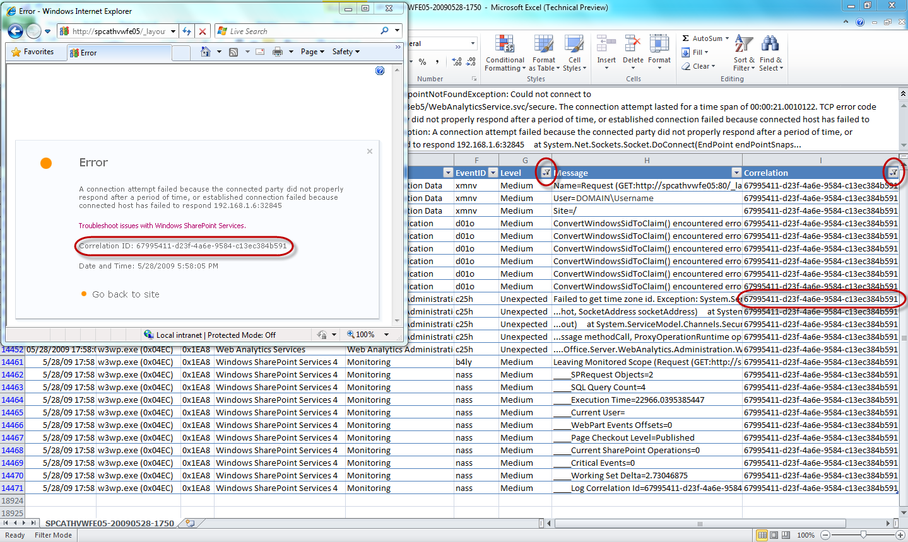
ULS Correlation IDs
Correlation ID
From the moment the page request starts through every layer
SQL Profiler traces will show the correlation ID
Notes:
In SharePoint 2010, the correlation ID tracing story is a really compelling one. From the moment the page request starts, we are logging a correlation ID through every level of the conversation until the page is rendered, error is shown, etc.
Correlation Id’s provide a mechanism to follow a conversation from when it was instantiated to when it was completed to include any exceptions raised within that conversation. Correlation Id’s can be followed across separate machines in the server farm environment. For example, if the Document Conversions Load Balancer Service is running on a single server and a related event occurs on separate Web front-end server, the correlation Id provides a facilitate to track the conversation and quickly identify the cause of the issue. Furthermore, SQL Profiler can be used to monitor and follow a conversation.
Enables an administrator to follow a conversation:
Presented as events are raised through the user interface
Exposed through SQL Profiler
Consider a scenario where you have a farm with multiple app servers, maybe Excel is hosted on a different server from the WFE... as that conversation happens across layers, you can experience the whole conversation in ULS by tracing the correlation ID. You can even see it in SQL Profiler traces if you happen to be running profiler. You can filter on the ID and see a much more defined view of information about the conversation.
How do you know the correlation ID? Well, if it is a failed page, we show it to you on the error page. If it is a successful page--well, we should wait for the Developer Dashboard to answer that question. :)

Slide 11
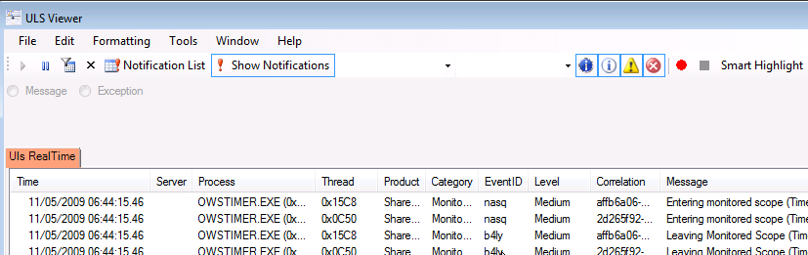
ULS Viewer
Available from: http://code.msdn.microsoft.com/ULSViewer
ULSViewer allows users to open a ULS log file and display its contents in a user friendly format. Users can perform advanced functions such as filtering, sorting, highlighting, loading logs, appending logs, etc in order to single out the data that is important to the user.
ULSViewer allows the user to:
Highlight data of importance to the user on the fly
Bookmark log entries
Append logs to other logs in order to track trends
Hide unimportant data
Only view critical log entries by sorting data by severity
Write rules to prompt the user when certain events occur
View your data in a spreadsheet instead of the text file ULS generates
Monitor remote machines logs that are running ULS services
Open multiple logs at the same time in order to compare log files
Open logs files from multiple machines at the same time.

Slide 12
Powershell and ULS
Commands
Get-SPDiagnosticConfig
Retrieves Diagnostic Configuration values from the farm
Set-SPDiagnosticConfig
Sets Diagnostic Configuration values
Get-SPLogLevel
Retrieves the logging level configured for a particular category
Set-SPLogLevel
Sets the event and trace level for a category
Clear-SPLogLevel
Resets the event and trace levels for a category to their default values
New-SPLogFile
Ends the current log file and starts a new one
Merge-SPLogFile
Combines trace log files from all farm servers into a single file
Example: Merge-SPLogFile –Path “E:\LOGS\TraceLogM.log” -Overwrite
Get-SPLogEvent
Reads/queries ULS trace logs
Notes:
Powershell is the core to managing ULS in Microsoft SharePoint Server 2010 through eight (8) unique nouns. The available Powershell nouns expose a number of configuration and management possibilities to both ease administrative burden and logging implementation.

Slide 13
Usage Logging

Slide 14
Usage Logging
SharePoint 2010 logs everything it does into the ‘Logging Database’
Enabled by default on all deployments
Customizable retention policy
Schema is documented
You can read, query and build reports directly from the Logging DB
3rd party apps can write their data to the Logging DB
SharePoint Web Analytics processes and use Logging DB data for advanced reports
Notes:
ULS Logs provide administrators with a great mechanism to diagnose what's wrong with the system when something goes wrong, but there are times when you want a overview of what's happening in your SharePoint deployment when things are going well.
For this, SharePoint 2010 provides you with the 'Logging Database' which contains all the events that are happening in the deployment. This information is collected by a service, the usage service, which collects system usage information and periodically imports them into the database.
Usage Logging is enabled on all deployments by default if you use the farm config wizard, but can be disabled by the admin at anytime, temporarily or permanently.
By default, in Beta 1, data in the database is retained for 14 days, but can be set by the administration through powershell
One of the most important feature of the logging database - the schema is public and documented. This means
- you can directly query against the tables in the database to obtain information and build reports - - If you're an ISV and building an application on SharePoint, you can add your own schema to the logging database for any custom logging that you want to do.
This extensibility also forms the basis for the new Web Analytics features in SharePoint Server 2010 which archives and analyses this data to provide rich reporting.

Slide 15
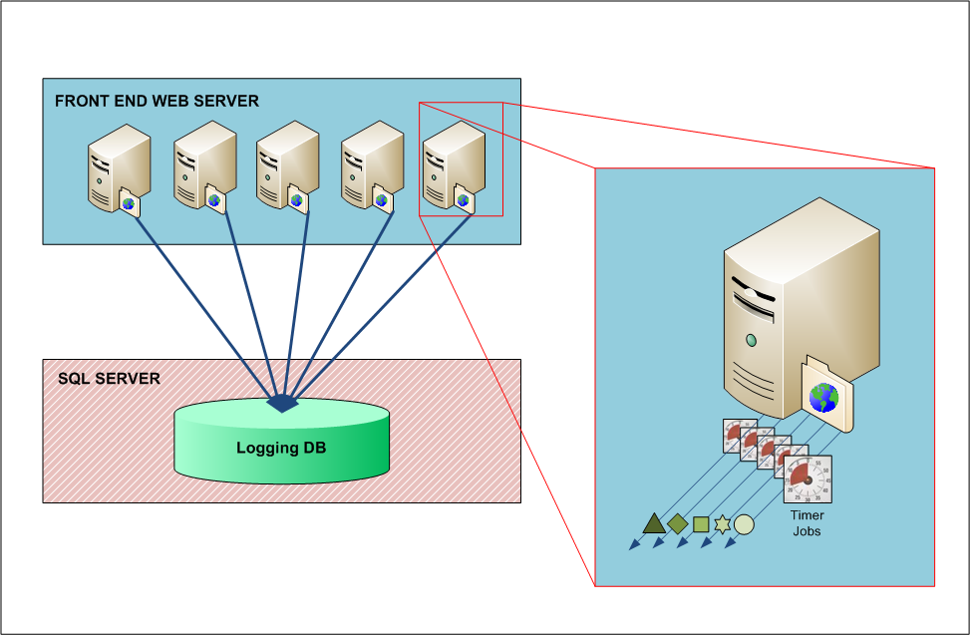
Logging Database and Diagnostic Providers
Collects
Performance counters
NT Event Log
SQL
Blocking queries
IO/CPU intensive queries
Search crawl and query statistics
Usage provider
Page requests
Timer Jobs
Feature Usage
Site Inventory
Notes:
NT Event Log Pick up all relevant event log entries on all the farm boxes
SQL Blocking Queries
Pick up all reported SQL blocking queries
SQL IO Intensive Queries
Pick up all reported SQL IO intensive queries
SQL CPU intensive Queries
Pick up all reported SQL CPU intensive queries
Performance Counters
Pick up all relevant System counters on all the farm boxes
Search Crawl and Query statistics
Pick up all the relevant Search Crawl events from the ETW (ULS)
Usage Provider
Timer Job Usage - Each timer job execution is recorded
Page Requests Usage – Each page requests (using HTTP Request Handlers) is recorded
“Feature” Usage - Each web part that renders is recorded
Site Inventory - A daily collection of site statistics gets recorded
Additional data gets pushed into the Usage Analytics service DB, including:
Query Usage - Each search query is recorded
Query Click Through – Each search result clicked is recorded
Query Results - Each search query result is recorded
Ratings – end user rating gets recorded

Slide 16
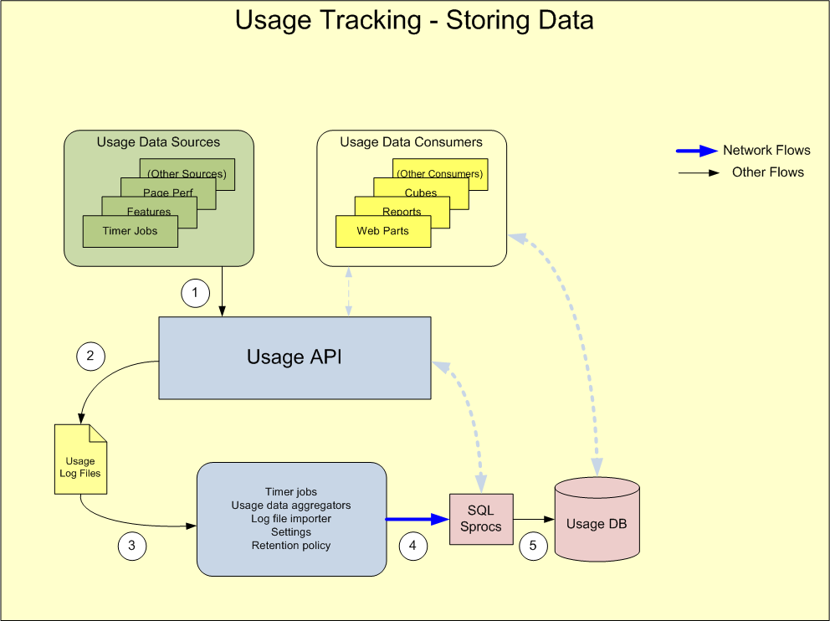
Logging DB – Storing Data
Provider writes data to Usage API
Usage API stores data in log files in file system
Timer Job imports data from files
Sproc called with new Data
That is added to Logging DB
Notes:
Key Message: It is important to understand the data storing cycle as the file system of every SharePoint server participates in it.

Slide 17
Logging DB - Data Storage
Entire process optimized for write speed
Data stored in partitioned tables rolled over to avoid deleting data
Retention period (14 days default) can be configured to up to 31 days at setup and run time (Powershell)
Changing Retention Period requires dropping and recreating tables
Notes:
Key Message: Data Storage is 14 days by default but can be adjusted with a script
One of the most important feature of the logging database - the schema is public and documented. This means
- you can directly query against the tables in the database to obtain information and build reports - - If you're an ISV and building an application on SharePoint, you can add your own schema to the logging database for any custom logging that you want to do.
This extensibility also forms the basis for the new Web Analytics features in SharePoint Server 2010 which archives and analyses this data to provide rich reporting.

Slide 18
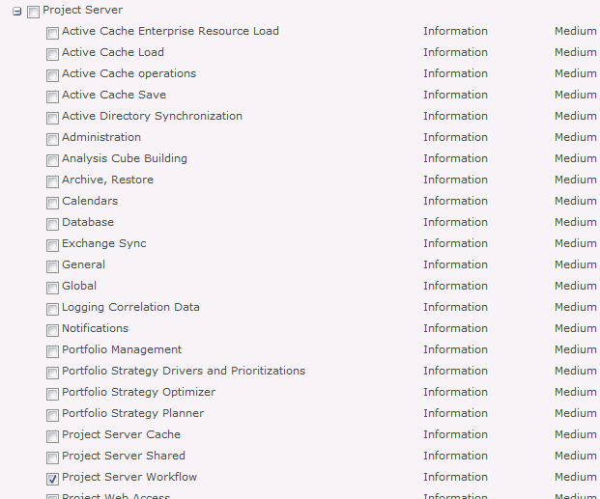
Usage Logging Configuration
Central Administration -> Monitoring -> Reporting -> Configure diagnostic logging
Notes:
Key Message: The Logging DB is configured in the Central Admin page
Here is where we configure the Usage Logging parameters.
The first section selects those events in the ULS logs that will be logged. It is important to select only those for which you will actually need data for since the amount of data generated can be very large.
In the second section we determine where the log files will be saved and the maximum size that the files can become.
In the third and fourth sections we control the timer job schedules which determine the rate at which data is pumped into the system and the reports are created
And in the last section we can setup the Logging Database connection parameters.
Logging is enabled on all deployments by default if you use the farm config wizard, but can be disabled by the admin at anytime, temporarily or permanently.

Slide 19
Powershell and Usage Logging
Get-SPUsageApplication
Retrieves usage applications from the local farm
New-SPUsageApplication
Creates a new usage application in the local farm
Set-SPUsageApplication
Updates settings for a given usage application
Remove-SPUsageApplication
Removes the given usage application from the local farm
New-SPUsageLogFile
Flushes usage data to current usage log file, and starts a new file in the current machine
Notes:
Get-SPUsageService
Retrieves the usage service local to this farm
Example: Get-SPUsageService [[-Identity] <SPUsageServicePipeBind>]
Identity: The identifier of the usage service being fetched. If no identity is given, the local usage service is returned
Set-SPUsageService
Updates settings for the given usage service
Example: Set-SPUsageService [[-Identity] <SPUsageServicePipeBind>] [-UsageLogMaxSpaceMB <UInt32>] [-UsageLogLocation <String>] [-UsageLogCutTime <UInt32>] [-LoggingEnabled <bool?>]
Identity: The identifier of the usage service being updated. If no identity is given, the changes are applied to the local usage service
UsageLogMaxSpaceMB: A number that specifies the ammount (in MB) of space that can be used by usage log files. The default is 5,000. The allowed range is 500 to 20,000 MB
UsageLogLocation: The path in every machine in the farm where usage log files will be created
UsageLogCutTime: A number that specifies the number of minutes of usage data collected per usage log file. The default is 30 minutes. The allowed range is 1 to 1,440 minutes
LoggingEnabled: A boolean value that specifies if usage data is being logged to usage files

Slide 20


Usage Logging - Reporting
ULS Logs
Windows Events
Feature Logging
Logging DB
Page requests
Health data
Notes:
A benefit of Usage Logging is to bring together diagnostic information from a variety of sources in the Project Server 2010 server farm and consolidate it into a single database that you can query and build reports on - using Excel , SQL Server or custom applications

Slide 21
Health Reports

Slide 22
Health Reports
New to Microsoft SharePoint Server 2010
Aggregates reports across server farm environment
Provides insight into overall farm performance as perceived by end users
Provides in addition site level usage reports
Can be used to facilitate troubleshooting efforts by proactively identifying problematic sites, pages, etc.
Leverages Usage Logging Infrastructure

Slide 23
Demo - ULS and Usage and Health Data Collection
Walk through ULS Logging UI
Walk through Usage and Health Data Collection UI
Notes:
Potential Demo Placeholder:
Keep focus on that fact that Ignite Demos need to be targeted at people that:
Already know Project Server 2007 and have deployed it
Want to see the new Project Server 2010 stuff from the ITPro/AdminPro perspective
Don’t want to see they same things they are going to see in general functionality oriented Project Server 2010 presentations
Want to get the info they need to deploy Project Server 2010 successfully

Slide 24
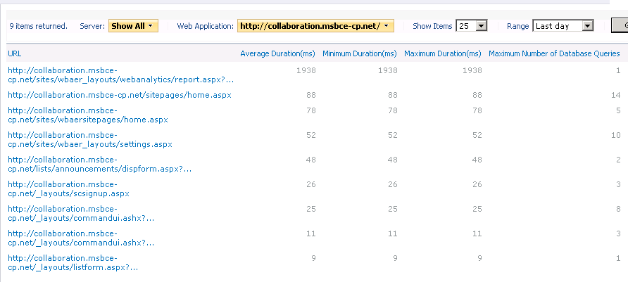
Example, General
Notes:
Microsoft SharePoint Server 2010 ships with Health Reports, Health Reporting is a subset of the Usage Logging and collects information about activity in a server farm environment, for example, at the farm level two (2) reports are available that provide insight into slowest pages and most active users, and at the site collection level, site usage, List and document inventory, etc.

Slide 25
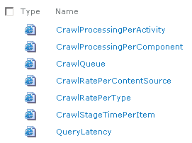
Example, Administrative, Search
Query Latency Report
Provides an administrator an immediate view of recent query activity
Average query count per minute is represented by a light purple line (using the right axis) which will likely fluctuate throughout the day
Average overall query latency per minute is represented by the second
Latencies per segment of the query pipeline

Slide 26
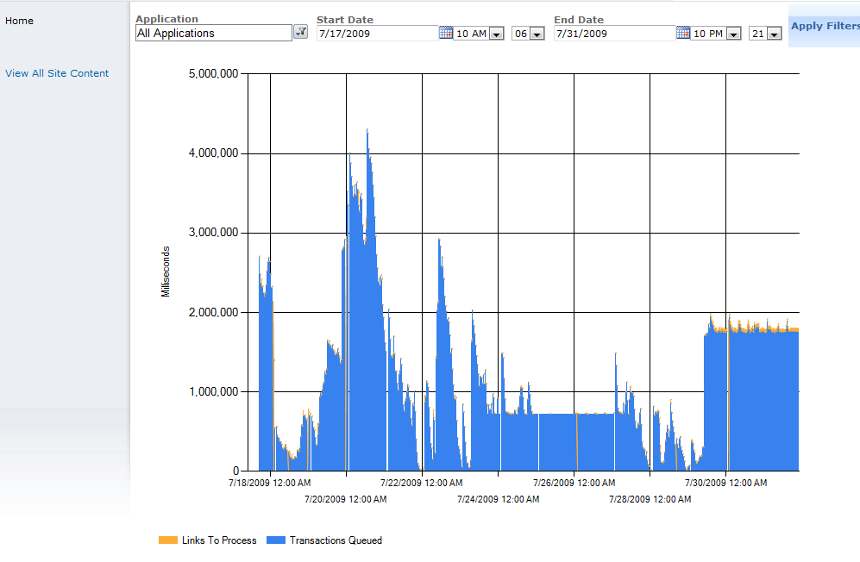
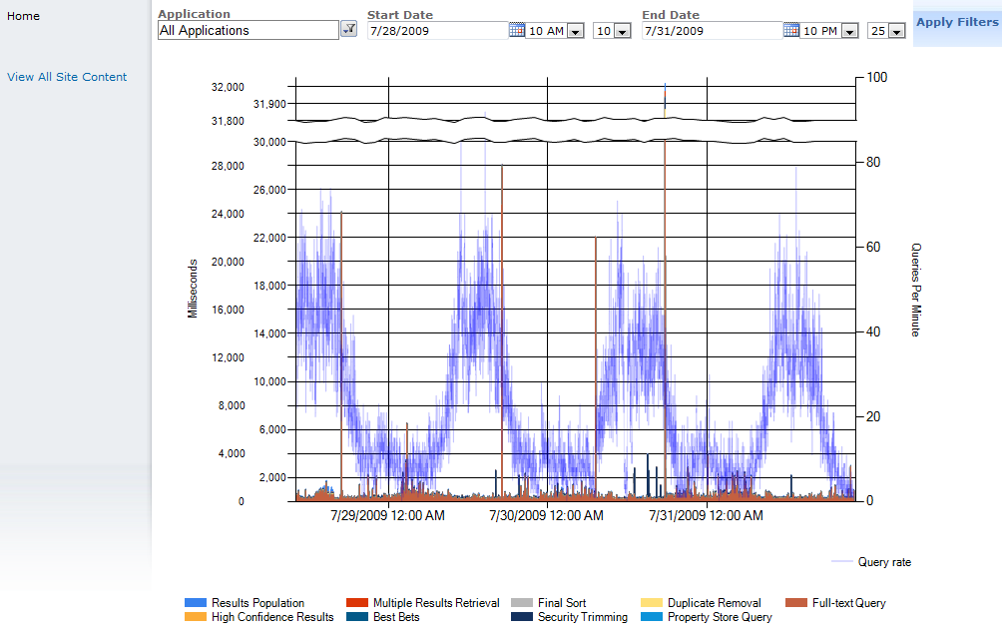
Example, Administration, Search
Crawl Queue Report
Query Latency Report
Notes:
Administration Health Report examples illustrating the Crawl Queue and Query Latency Reports. The Query Latency Report is useful ) in understanding what query load looks like, when is the peak, and how long does it last.
So, the analysis looks like this:
Where is the spike occurring? Full-Text Query. This means your query servers are experiencing difficulties
What happened to your query servers at the time of the spike. Hint – look at the event log and you will see Master Merge events at the exact same time as the spike.
Why is MM effecting query latency so dramatically?
The drives / memory on the machine is inadequate.

Slide 27
SharePoint Health Analyzer

Slide 28
SharePoint Health Analyzer
Categorizes and reports on common configuration issues in a server farm environment
Implements the Best Practices Analyzer engine (Windows SharePoint Services 3.0)
Provides definitions on four unique categories
Security
Performance
Configuration
Availability
Farm-level, cannot be partitioned
NOTE: Rule definitions are extensible
Notes:
The SharePoint Health Analyzer is new to SharePoint Server 2010
Proactive management engine to identify and resolve problems in the server farm environment
Developed on the Best Practices Analyzer engine
Executes under a Timer Job definition
Reports issues in Central Administration and System Center Operations Manager(SCOM)
The SharePoint Maintenance Engine (SPME) is part of the central Admin UI and is used to determine any configuration issues that may cause services to function sub-optimally. The monitoring component consists of code-based or XML-based rules that check against settings to determine the health of the server. These rules are run at a scheduled time, but can also be run at will. When a rule check fails, a warning is surfaced to the administrator, and if the rule provisions for an automatic repair action, the admin can select it, and choose to auto-repair the rule in the future. Farm administrators can additionally write their own rules and modify settings for rules that ship in the box.

Slide 29
Rules
Rules are mapped to services
Run on one or all instances of that service
Rule exceptions provide additional context where available (i.e., pointer to published guidance)
Will periodically check the download center for new rule packages
The rules will execute using our timer service account credentials, which should have full permission to SharePoint and it’s databases

Slide 30
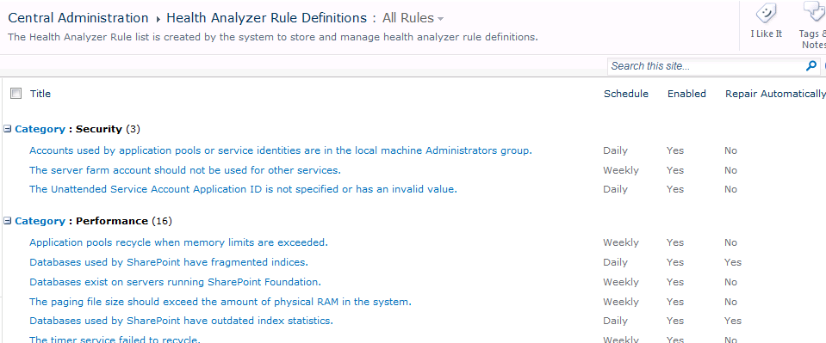
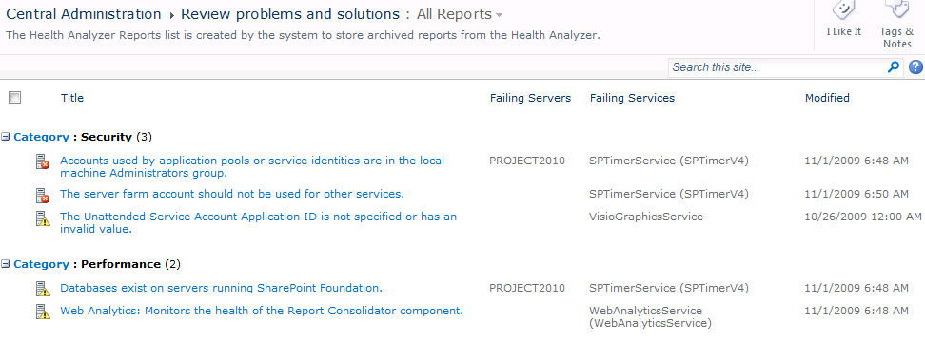
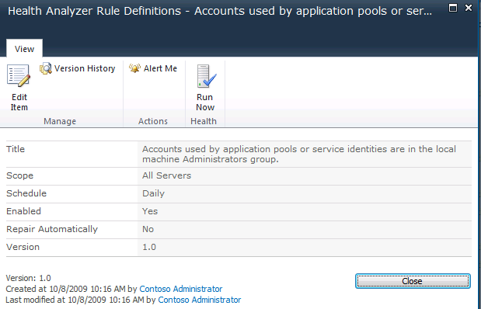
Rule Results and Details
Notes:
Include SharePoint Management Engine (SPME) rules into manageability planning

Slide 31
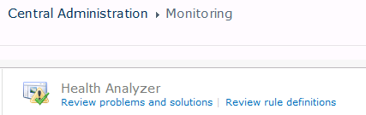
Administrative UI
Central Administration
Under “Monitoring” -> “Health Analyzer”
“Review problems and solutions”
“Review Rule Definitions”

Slide 32
Patch Health Rules
New feature in SharePoint 2010
Include several rules that pertain to patching:
Databases require upgrade
Databases are running in compatibility range, upgrade recommended
Product/patch installation or server upgrade required
Can be used to keep administrators aware of potential problems and address them
Notes:
A new feature in SharePoint 2010 is Health Rules. Health Rules work like alerts, but they alert you to changes in your SharePoint farm configuration, not your SharePoint content. Health Rules can be delivered either via e-mail or SMS messages. An administrator can also view all of the health reports and click on them for guidance on addressing them.
The SharePoint administrator can leverage these health rules to keep track of when patches are available to be installed, as well as when databases should be upgraded. When a patch needs to be installed the administrator will be notified. They can then go into Central Admin to view the health reports and apply the necessary patches to the servers where they are needed. After all of the servers are at the same patches level, the administrator can move on to upgrading their databases.

Slide 33
Demo - SharePoint Health Monitoring
Walk through where SharePoint Health Monitoring puts information
Highlight things that have been brought into SharePoint via diagnostic providers that used to have to be found in log files individually
Highlight any new OOB reporting capabilities that help the ITPro assess farm and EPM health more readily and easily
Notes:
Potential Demo Placeholder:
Keep focus on that fact that Ignite Demos need to be targeted at people that:
Already know Project Server 2007 and have deployed it
Want to see the new Project Server 2010 stuff from the ITPro/AdminPro perspective
Don’t want to see they same things they are going to see in general functionality oriented Project Server 2010 presentations
Want to get the info they need to deploy Project Server 2010 successfully

Slide 34
DEVELOPER DASHBOARD

Slide 35
Developer Dashboard
The developer dashboard is a useful component included with 2010
Can be used to monitor page load and performance
It has three states
On
Off
On demand

Slide 36
Developer Dashboard
Displays detailed diagnostics for each page load
Eases diagnostics of performance issues
Disabled by default
Enabled through PowerShell or stsadm
Once it's enabled, any site admin can access it to diagnose their sites
Notes:
The Developer Dashboard provides developers and administrators informative data to facilitate discovery and root cause of page malfunctioning, performance, call stack access and exception information in error messages.
The Developer Dashboard displays detailed diagnostic information on each page that you load it on. It's disabled by default and is enabled by the farm admin through PowerShell. Once it's enabled, any site admin can access it to diagnose their sites.
*Queries displayed are only for that page fetch. If the rendering of the page has more than one, then only latest page fetch info displayed.
When enabling the Developer Dashboard the following message is presented in the command prompt.
Warning: The developer dashboard is now enabled. Confidential information about the farm topology may be exposed to users. This information includes, but is not limited to server and database names. If this is a production environment and you are concerned about information disclosure, consider disabling the dashboard by executing c:\program files\common files\microsoft shared\web server extensions\14\bin\stsadm.exe -o setproperty –pn developer-dashboard –pv off
First Page Request will be trimmed so we do not expose the data related to the .aspx compilation and the queries related to initialization.
Additionally, enabling the Developer Dashboard is prevented if SQL authentication is used as a security measure.
Enable/disable through STSADM or Powershell:
Examples
STSADM
STSADM -o setproperty -pn developer-dashboard -pv on
STSADM -o setproperty -pn developer-dashboard -pv off
STSADM –o setproperty –pn developer-dashboard –pv OnDemand
Powershell
Set-SPFarm –DeveloperDashboardEnabled
Set-SPFarm –DeveloperDashboardEnabled $false

Slide 37
Developer Dashboard
Information contained on the dashboard:
Times to render various components on page
Page Checkout level
Database query information
Web part processing time
Any critical events or alerts
Good for diagnosing problem web parts on a page or long list load time

Slide 38
Developer Dashboard
The Developer Dashboard state can only be toggled with a STSADM command
ON:
STSADM –o setproperty –pn developer-dashboard –pv on
OFF:
STSADM –o setproperty –pn developer-dashboard –pv off
ON DEMAND:
STSADM –o setproperty –pn developer-dashboard –pv ondemand

Slide 39
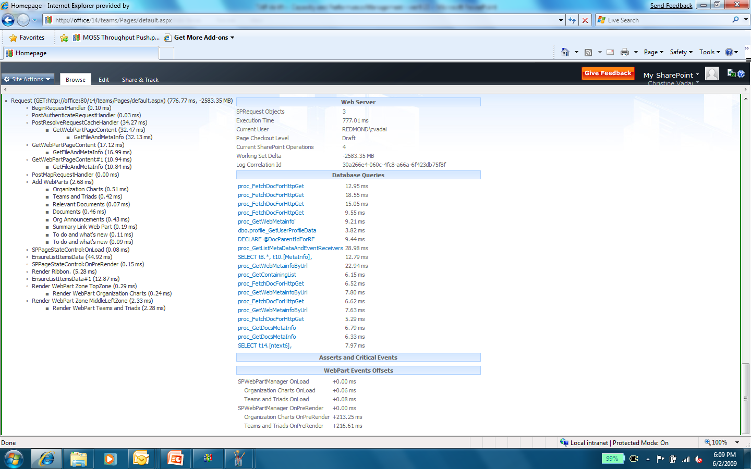
Dev Dashboard – Debug Info
Request info: server-side latency, correlation data
SQL queries invoked by page request
Cost per function call
Cost per web part
Notes:
Key Message: Here is a detailed page
Once the icon is clicked the page is re-executed. Then you can scroll down and view the detailed debug info that lets you know exactly what happened. There is a ton of useful data here that can quickly identify a problem. In this case, it executed in 777 ms, which seems reasonable. However, our goal is no more than 4 SQL queries per page, and we obviously have many more than that. We also have two expensive web parts that each cost 200 ms. If we need more data, we again have the correlation ID that we can use to look in the ULS logs and the logging DB to discover any additional info from there.

Slide 40
Demo - Developer Dashboard
Walk through a Developer Dashboard
Notes:
Potential Demo Placeholder:
Keep focus on that fact that Ignite Demos need to be targeted at people that:
Already know Project Server 2007 and have deployed it
Want to see the new Project Server 2010 stuff from the ITPro/AdminPro perspective
Don’t want to see they same things they are going to see in general functionality oriented Project Server 2010 presentations
Want to get the info they need to deploy Project Server 2010 successfully

Slide 41
Password Management

Slide 42
Password Management
Managed Accounts enable Password Management
a.k.a. “Password Roll” (still broken in Beta1 for some Services)
Can Detect Account Policies
Password changed X days before expiry
Email Notification
Automatic Change Schedule
Implemented as Timer Job
Wait time notifies services of impending change
Pass Phrase (PSConfig)
Allows credentials to be retrieved
Password Retrieval via custom code no longer possible!

Slide 43
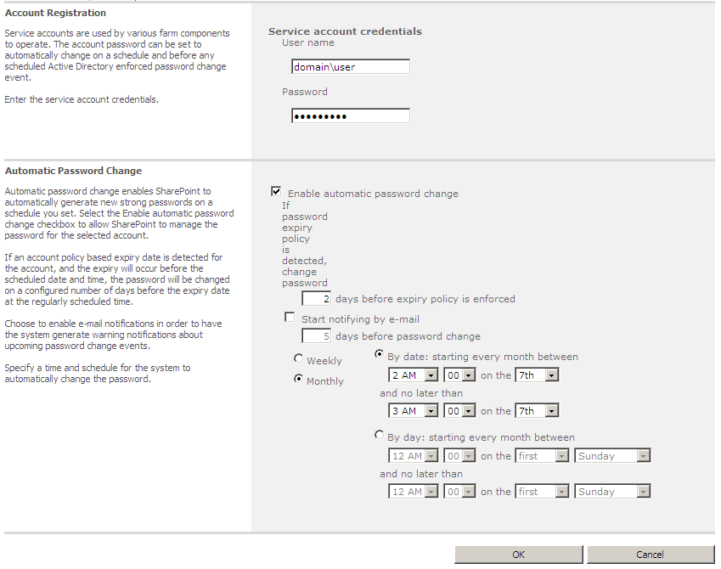
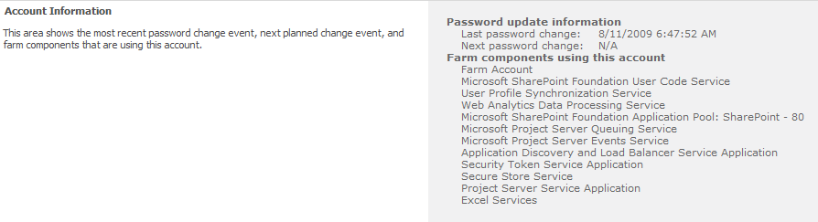
Managed Accounts
Notes:
$useraccount = “domain\username"
$securepassword = ConvertTo-SecureString -string "123`$ABC" -AsPlainText -force
$managedappaccount = New-SPManagedAccount -password $securepassword -Username $useraccount

Slide 44
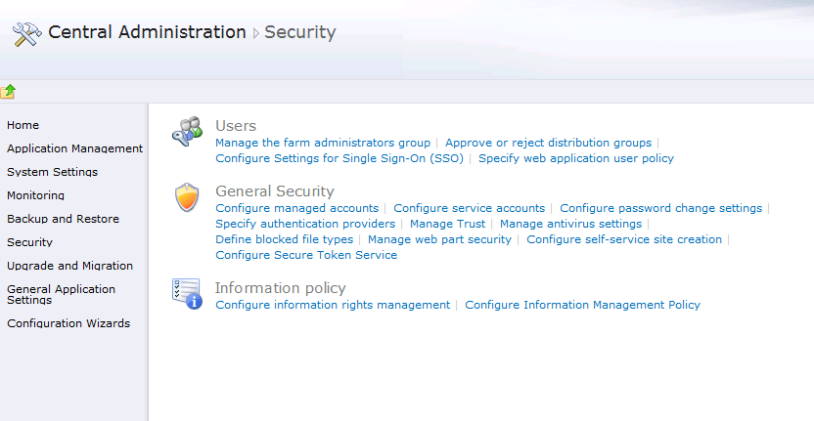
Password Rollover
Create a Managed Account with service account
Configure auto password rollover

Slide 45
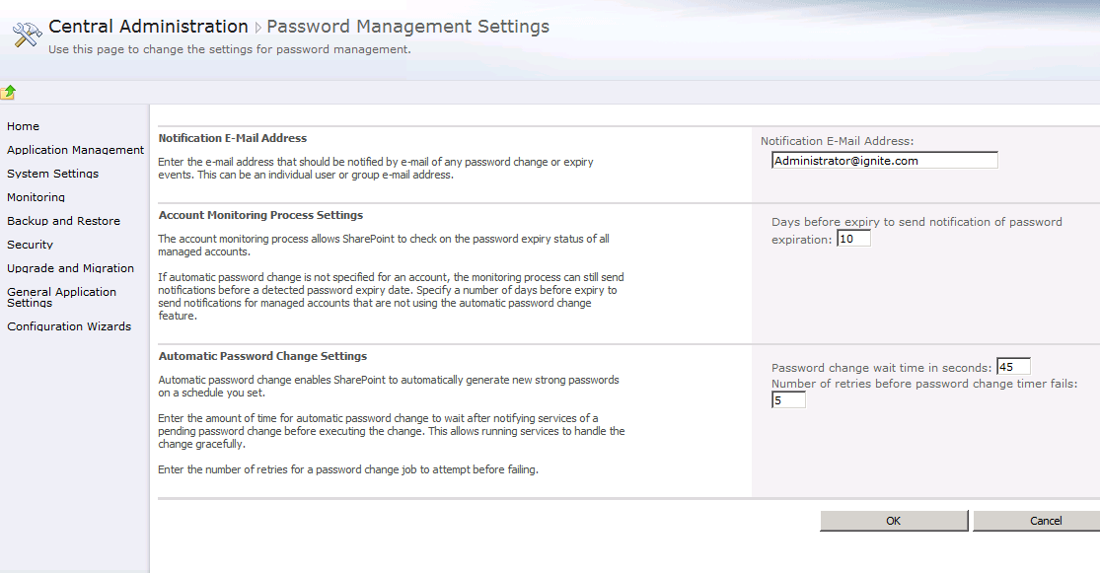
Password Rollover
Auto-password generation/change
Prevents service account lockout

Slide 46
Powershell

Slide 47
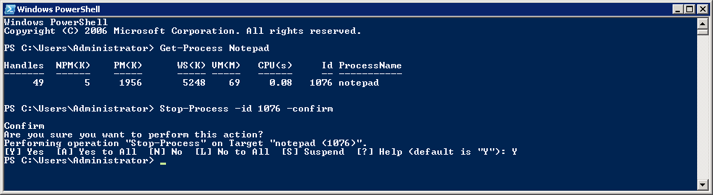
PowerShell Introduction
What is PowerShell?
A modern replacement for the CMD (command) shell
A powerful scripting environment for administration
PowerShell fundamentals
Cmdlets (e.g. Get-Process and Stop-Process)
Pipelining and formatting features
Provider-based model for accessing resources
Notes:
Windows PowerShell Snap-ins and Commands
The next version of SharePoint Products and Technologies extends the core functionality of Windows PowerShell by providing its own set of PowerShell snap-ins that contains SharePoint providers and SharePoint commands.
PowerShell is a new command-line shell and task-based scripting technology that provides information technology (IT) administrators comprehensive control and automation of system administration tasks, increasing administrator productivity. PowerShell includes numerous system administration utilities, consistent syntax and naming conventions, and improved navigation of common management data such as the registry, certificate store, or Windows Management Instrumentation (WMI). PowerShell also includes an intuitive scripting language specifically designed for IT administration.
For more information about PowerShell see the Windows PowerShell homepage (http://www.microsoft.com/windowsserver2003/technologies/management/powershell/default.mspx).
PowerShell introductory materials : http://www.microsoft.com/technet/scriptcenter/topics/winpsh/manual/start.mspx

Slide 48
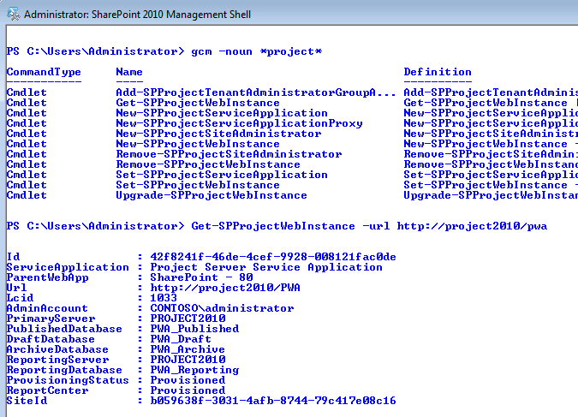
PowerShell and Project Server 2010
Transition of STSADM to PowerShell in 2010
Project Server 2010 has 7 PowerShell commands, mainly around provisioning
Not all commands have migrated for 2010
Use the SharePoint PowerShell command environment
Notes:
Windows PowerShell Snap-ins and Commands
The next version of SharePoint Products and Technologies extends the core functionality of Windows PowerShell by providing its own set of PowerShell snap-ins that contains SharePoint providers and SharePoint commands.
PowerShell is a new command-line shell and task-based scripting technology that provides information technology (IT) administrators comprehensive control and automation of system administration tasks, increasing administrator productivity. PowerShell includes numerous system administration utilities, consistent syntax and naming conventions, and improved navigation of common management data such as the registry, certificate store, or Windows Management Instrumentation (WMI). PowerShell also includes an intuitive scripting language specifically designed for IT administration.
Developers will be able to create custom cmdlets with special PowerShell project template included in Visual Studio 2010
For more information about PowerShell see the Windows PowerShell homepage (http://www.microsoft.com/windowsserver2003/technologies/management/powershell/default.mspx).
PowerShell introductory materials : http://www.microsoft.com/technet/scriptcenter/topics/winpsh/manual/start.mspx

Slide 49
PowerShell for Patching
Central Administration is not the only option for upgrading databases
PowerShell can be used to determine database patch level
Use Get-SPContentDatabase
PowerShell can also be used to upgrade database
Use Upgrade-SPContentDatabase
Using PowerShell Add-SPContentDatabase may also upgrade it
Can be used to upgrade databases with multiple Project Server 2010 servers
Notes:
While you can upgrade your databases in Central Administration, you can also use Upgrade-SPContentDatabase in the SharePoint Management Console to do this. If your farm has many content databases or many SharePoint servers you can use PowerShell to more quickly and efficiently upgrade your databases. Using PowerShell you can easily kick off multiple database upgrades on multiple content databases simultaneously. Using PowerShell scripts also has the benefit of a consistent database upgrade experience. This reduces the chances of a problem during upgrade, as your process has been vetted and used many times. The scripts are also portable and can be used to upgrade your test and recovery environments.
PowerShell also has a cmdlet that allows you to interrogate a database and determine whether it requires upgrade. Get-SPContentDatabase is a quick way to determine if you should upgrade your databases.
Since you can use PowerShell to add content databases to your farm, this is another way it can upgrade databases.

Slide 50
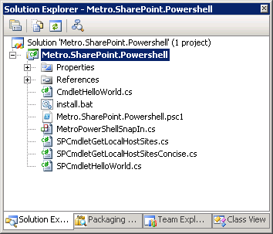
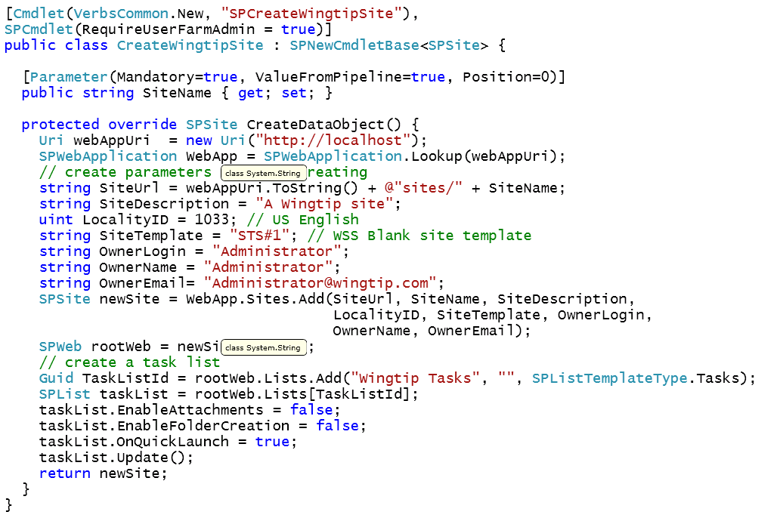
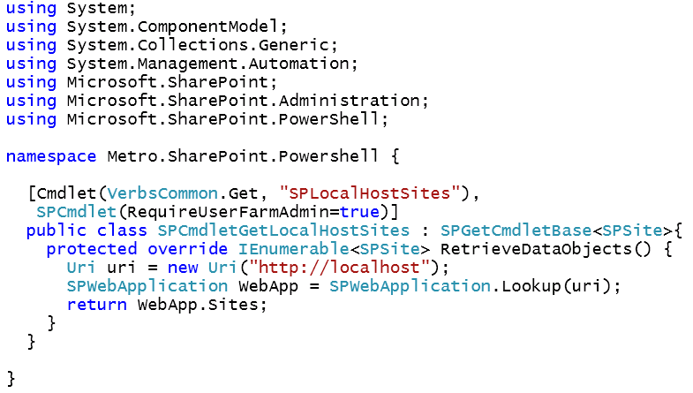
Powershell Extensibility
PowerShell was created with extensibility in mind
PSI developers can create new PS2010 cmdlets
STSADM extensions now considered deprecated
Notes:
PS2010 = Project Server 2010
Developers will be able to create custom cmdlets with special PowerShell project template included in Visual Studio 2010.

Slide 51
Demo – PowerShell
Walk through a PowerShell script

Slide 52
Questions?

Slide 53

© 2009 Microsoft Corporation. All rights reserved. Microsoft, Windows, Windows Vista and other product names are or may be registered trademarks and/or trademarks in the U.S. and/or other countries.
The information herein is for informational purposes only and represents the current view of Microsoft Corporation as of the date of this presentation. Because Microsoft must respond to changing market conditions, it should not be interpreted to be a commitment on the part of Microsoft, and Microsoft cannot guarantee the accuracy of any information provided after the date of this presentation. MICROSOFT MAKES NO WARRANTIES, EXPRESS, IMPLIED OR STATUTORY, AS TO THE INFORMATION IN THIS PRESENTATION.

Slide 54
APPENDIX

Slide 55
Patching

Slide 56
Patching/Upgrade Processing Improvements
Fewer schema alteration actions
Database Upgrade State indication (avoid round trips)
Notes:
A lot of work was put into making the patch process more efficient. The more quickly a patch installs, the less downtime your users experience. Reducing the amount of changes made to the databases is one way this is achieved. Modifications are very expensive so reducing them has a very noticeable benefits.
One example of this is with the stored procedures in each database. In the past, the upgrade process has dropped all the existing stored procedures, upgraded the database schema, then added the new stored procedures. This was done with no regard to how different the stored procedures where. In SharePoint Server 2010 the patching process does not automatically drop the existing stored procedures. Instead it compares then with the new stored procedures and only makes changes to them as necessary. This is less network traffic and less work for the SQL server. This also removes the chances of you losing all your Procs if something interrupts the patching process.
More performance improvements were made by more efficiently querying the databases. The installer reduces trips to the database by saving locally the information it queries from the databases when it knows it will use that information more than once. This reduces database trips as the same query shouldn’t ever be made more than once. It also resulted in the installer being more efficient in how it accesses the database.

Slide 57
Patching Process Versus Upgrade Process
Installing patches has two distinct parts
Patching
Laying down bits
Stopping services to replace in use files
Deployment
Installer copies support files to the appropriate places on the SharePoint server
Upgrade
Moves moving parts up to new version
Services
Databases
The upgrade process is the one that takes the longest and does the most work
Notes:
To fully understand the patching process, we have to break it down into a few consumable steps. To fully install a patch you have to finish the patching process and the upgrade process.
The patching process has two steps, the patching step and the deployment step. The patching step comes first. It’s the step that initially writes the new bits to the server. It will temporarily stop any services that are using files it replaces. This is to prevent the need for a full server reboot to replace the in use files. In most cases this will work, but it does not completely remove all instances of server reboots.
The second step in the patching process is the deployment step. In this step the installer copies support files to the appropriate places on the SharePoint server. This step ensures all your web applications are running the correct bits and will function correctly. After the deployment step is finished the patching process is complete.
To finish the patch installation you will need to initiate the upgrade process. You’re probably familiar with this as the place where you have to run PSConfig when doing patches. The upgrade process is the one that takes the longest and does the most work. It first upgrades all the SharePoint processes that are running. Then it starts walking through your databases and upgrading them. The upgrade process can run on a single server, leaving the other servers in your farm to serve up requests.

Slide 58
Allowing Bits Upgrade Separate from Database Upgrade
Patches can be installed on servers without immediately incurring downtime
Bits can be installed gradually
Roll a WFE out of rotation
Apply patches
Roll WFE back in rotation
Repeat
Database upgrades can be done at a convenient time
Notes:
To make patch installation less disruptive for end users, patch binaries may be installed without upgrading the databases. You can patch the binaries on all of your servers during the workday by shuffling them in and out of your load balancer. Your farm can run with binaries that are later than your database schema until you can schedule downtime to upgrade them. Your database can also be upgraded gradually. This gives you the flexibility to upgrade databases when it will least impact the users that use them.
When you decide to upgrade your databases you can do it either through Central Admin or with PowerShell.

Slide 59
Patching Process versus Upgrade Process continued
Service Applications
Downtime of those services can be mitigated by having multiple machines running the service
To make sure that the service doesn’t get confused (during round robin), you’d remove the machine from the farm, patch, and then add it back in

Slide 60
Patching process versus upgrade process continued
Upgrade
Powershell now allows you to kick off multiple upgrades at the same time
Ideally use multiple SQL servers in parallel, and then use the stsadm –o preparetomove command to move the databases

Slide 61
Upgrade Method – In-Place
Databases to be upgraded are already attached to the farm
Patch is installed via EXE (preferred) or MSP
Patch and upgrade is separated into two steps
PSConfigUI manages locks to manage multiple instances
Notes:
This is the most obvious and deliberate way to install patches on your EPM farm. You download the patch, copy it to all of your servers and install it. After it is installed you need to upgrade your databases by initiating the upgrade step. The big change from 2007 is that the upgrade process no longer requires you to run the Config Wizard on your SharePoint servers in a specific order and click OK at specific times. You can fire up Config Wizard on all members of the farm and let them run to completion. The Config Wizards can run simultaneously and will finish without human intervention. To keep things running smoothly the upgrade process locks the objects it is upgrading, allowing concurrent processes to know where it’s at and wait.

Slide 62
Upgrade Method – DB Attach
Databases can be upgraded by attaching them to farm at a later patch level
This can be their original farm, or an “Upgrade Only” farm
Use Mount-SPContentDatabase in PowerShell to attach the database and upgrade it
Can also be mounted without upgrade
Used to control downtime and maximum upgrade speed
Notes:
You could spin up another farm to use solely to upgrade your databases, if you have the SQL LUNs and spare hardware.
You also have the option of detaching all your databases before you install the patch, then control their upgrade by reattaching them. You have a lot of flexibility to match your company’s needs
While attaching content databases to your farm *may* upgrade them, you shouldn’t rely on it. In the SharePoint 2007 time frame it was a common practice to remove content databases when installing patches, then adding them back to your freshly patched farm. This gave you some control over when the databases were upgraded, and it gave you some indication as to how far along through the upgrade process you were. That’s no longer necessary.
You could spin up another farm to use solely to upgrade your databases, if you have the SQL LUNs and spare hardware.
Using the Attach method to upgrade databases is not recommended for two reasons:
It may not upgrade the content database if the database is within the compatibility range
Attaching the database fires up other processes like Site Directory Scan

Slide 63
Backwards Compatibility
Patches are built to be compatible with databases at previous patch level
This gives some flexibility on when patches are installed, and when databases are upgraded
Don’t leave in this state too long, it can cause some inconsistent behavior
Notes:
Patches will be tested and verified to support database schemas one level back, with Service Packs normally being a backwards compatibility boundary. By extension the bits should work with any previous database versions back to the last service pack.
The backward compatibility is per feature. The STS feature may be compatible with one patch back, but another patched process may not be. That will be avoided at all costs though.
Your farm shouldn’t be left in this situation for an extended period of time, only for a few days.

Slide 64
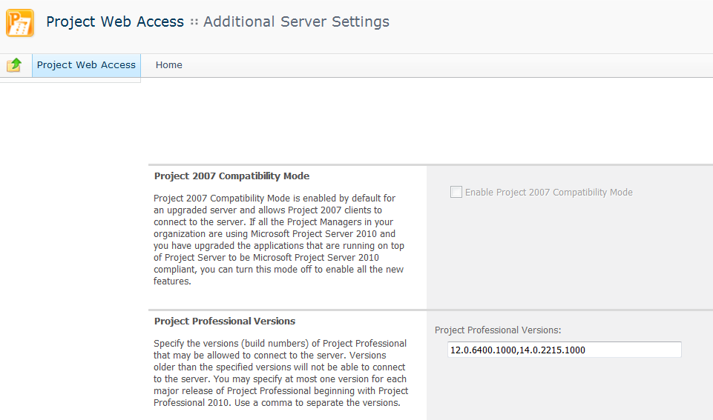
Limit Project Versions Connecting
PWA -> Server Settings ->Operational Policies -> Additional Server Settings
Now possible for administrators to control the versions of Project Professional allowed to connect to PWA instance

Slide 65
Central Admin UI showing farm status (including upgrade)
One location to see the patch status for all the members of your farm
Can show entire farm or individual members
Can tell if a server has a patch that needs to be installed
Also shows status of databases as well as their type
Notes:
There’s a tab in Central Administration dedicated to Upgrade and Migration. From here administrators can see the patch level your entire farm or individual servers are at. Click “Check product and patch installation status” to see the status of server farm machines. It shows the effective patch level of each of the products installed on each of the members of the farm. If a patch needs to be applied , administrators will be alerted to it there. Great place to go when trying to determine “What build is my farm at?”
Available Patching and Upgrade Status information in Central Administration:
Upgrade and Patch Management UI
Manage Patch Status UI
Manage Database Upgrade Status UI
As an administrator you have a couple of options around how to monitor your patch progress. You can use the “Upgrade and Migration” page to watch the status of the running upgrade jobs, and the status of individual pieces, be that binaries or databases.
If you are scripting your patch installs, you can also monitor in PowerShell with Get-SPContentDatabase or Get-SPDatabase. Validate NeedsUpgrade Property

Slide 66
Patch Management
Farm Status UI (CA-> Upgrade and Migration - >Check product and patch installation status)
Status Value | Description | Hyperlink
No Action Required | Farm server does not currently require any action to be taken by the administrator. | Not a hyperlink.
Installation Required | Farm server is missing an MSI that is set to mandatory for all farm servers or has an MSI patch level below the individual MSI Farm Wide Effective Patch Version. | Hyperlink to the Patch Deployment State page.
Upgrade in Progress | Farm server is currently undergoing an upgrade operation. | Hyperlink to the Upgrade Status page.
Upgrade Available | Farm server is running in backwards compatibility mode. | Hyperlink to the Upgrade and Migration page.
Upgrade Required | Farm server is outside of the backwards compatibility mode range with one or more databases. | Hyperlink to the Upgrade and Migration page.
Upgrade Blocked | If an upgrade is available and any farm server requires installation then the remaining servers that do not require installation will be set to this status unless they are currently undergoing an upgrade. | Hyperlink to the Patch Deployment State page.
Status Value | Description
Installed | Shown to indicate that no action is required.
Missing/Required | Shown if a product is required on each server or if a patch for a given MSI is on one server but not the one this status is shown for.
Missing/Optional | Shown if a product is not required on each server.
Superseded | Shown if a patch is no longer required on a server because a newer patch supersedes it.
Notes:
Here’s a quick guide to the different Statuses you might encounter and what they mean.

Slide 67
PSConfig/PSConfigUI Patch Detection
PSConfig can be run on multiple boxes concurrently
Databases can be upgraded simultaneously
PSConfig will put a lock on any content it is upgrading
Each instance of PSConfig looks for a lock or the upgrade status
Upon new server install, PSConfig will query the farm for patch levels and alert you if patches are needed
Notes:
To minimize the amount of downtime your farm has during a patch upgrade, each farm member can upgrade databases. When an instance of PSConfig is upgrading content, it puts a lock on it to prevent other instances from trying to upgrade it at the same time.
As PSConfig runs on each member it detects the database level and lock status to determine whether it has been upgraded.
This functionality exists in both the UI version of PSConfig as well as the scriptable one. This means you can run PSConfig immediately after patching the binaries on each server without worrying where the other servers are in the process.

Slide 68
Automatic Deployment Mechanism
Supports major update methods
WSUS
Windows Update
Microsoft Update
Updates binaries only, not content
Health monitoring rule alerts Administrators
Notes:
To minimize the amount of time needed to patch Project Server 2010 server, farm administrators can choose to have their services automatically install patches when made available through a variety of automatic patching mechanisms. This includes Windows Server Update Services (WSUS), Microsoft Update and Windows Update.
If AutoUpdate is enabled your server farm boxes will automatically apply patches when they come down. It will do this under the context of NT Authority\LocalSystem. Because that account has no access to your databases, only the Patching step is performed.
You must still perform the Upgrade step yourself. The patch bits will be laid down, services will be stopped if necessary and the bits will be copied to your web applications as needed. Then your server goes back to happily serving out pages to your users.
The patch install will trigger a health rule which will alert you that a patch has been installed and that your databases need to be upgraded to match the bits that are running. The process is the same if you have a single server in your farm or many. They individually patch themselves as they get the patch but none will upgrade your databases. That will always be a deliberate process.

Slide 69
No Separate SharePoint Patches
Only one patch install required for either version of SharePoint 2010
Windows SharePoint Services patch install no longer needed for SharePoint 2010 patch install
Less time needed to patch servers
Less confusion and room for error
Notes:
WSS = Windows SharePoint Services
With Project Server 2010 you no longer need to install the Windows SharePoint Services patches before you could install the same patch for SharePoint Server. Starting in SharePoint 2010 patches are stand alone. There will be a single patch for WSS, and there will also be single patches for SharePoint Server and for Project Server. In the past this was necessary because WSS was included as part of Windows Server and code changes for Windows could not be included with other products. SharePoint 2010 is a standalone product now, so this restriction is removed.

Slide 70
Business Continuity Management
Ignite World Wide Tour
Microsoft Corporation

Slide 71
Agenda
High Availability Features
Backup and Restore Capabilities
Database Mirroring
Disaster Recovery Between Farms
Backup and Restore Recap

Slide 72
High Availability Features

Slide 73
Fault Tolerance
Redundancy extends across server roles
Configure more than one server for each role
Multiple Project Service Application app servers provide redundancy
Search index now fault tolerant within a farm (stateless, no longer stores a copy of the index)

Slide 74
High-Availability Improvements
Full Support for SQL Server Mirroring
Can be specified for each content database
Can detect when primary database is not longer available and will attempt to connect to the mirror database without human intervention
Log Shipping
Log-shipped content databases can be attached to a SharePoint farm and are treated like a read-only content database
Notes:
Full Support for SQL Server Mirroring
SharePoint 2010 will detect when the primary database is no longer up and running and will attempt to connect to the mirror database without need for human intervention. Additionally, a failover database can be specified for each content database using SharePoint Central Administration or PowerShell. When the primary database is unavailable, the failover database will automatically be used.
Log Shipping
Log-shipped content databases can be attached to a SharePoint farm and are treated like a read-only content database.

Slide 75
High Availability Improvements
Backups from SQL Snapshots
Allows point-in-time backup without locking site collections and reducing availability
Unattached Database Backup and Export Operations
Allows review of content databases without attaching them to the SharePoint farm
Notes:
Backup from SQL Snapshots
All backup operations can be performed on a SQL snapshot, without worry about corruption from continual changes. Backup from SQL snapshots works with all databases, including unattached databases and read-only databases. This allows you to back up a point-in-time copy of the database without locking site collections or reducing availability.
Unattached Database Backup and Export Operations
You can connect to a database that is not directly attached to a SharePoint farm. Once connected, the content of the database can be browsed, and the site collection, site, or list of choices can be exported to a file. This can be used to connect to an older copy or to a backup of a content database in order to enable a site collection “roll-back” scenario; alternatively, data can be retrieved from a hot backup or a SQL snapshot to facilitate accident recovery.

Slide 76
Unattached Content Database
Granular restore and content browsing of “offline” database
Browse content
Explore site collection content
Backup site collection
Backs up to File System as .bak artifact
Leverages Timer Service infrastructure
Export site or list
Exports to File System as .cmp artifact
Can include Security and Versions
Mitigates requirements to support expensive dedicated restore environments
Facilitates a mechanism to test and verify backup fidelity
Notes:
DPM = Data Protection Manager
Provides DPM-like functionality natively:
Is not a DPM replacement
Provides limited capabilities

Slide 77
Unattached Content Database Restore
User interface to facilitate restore is not available
Use PowerShell
Restore-SPSite with export
Restore–SPSite http://<server>/sites/site -path \\<share>\site.bak –overwrite
Import-SPWeb with site or List
Import–SPWeb http://<server>/sites/site/web -path \\<share>\web1.cmp -includeusersecurity
Notes:
R0sev!lle

Slide 78
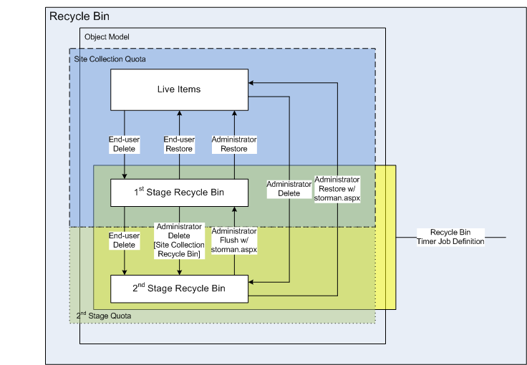
SharePoint Recycle Bin
Relatively unchanged from previous versions
Facilitates self-service content recovery

Slide 79
Backup and restore capabilities

Slide 80
Backup & Restore
New! Site Level Backup and Restore
New! Workspace Relinking Tool
Allows you to relink your project workspaces with the projects after restore
Command line interface using STSADM

Slide 81
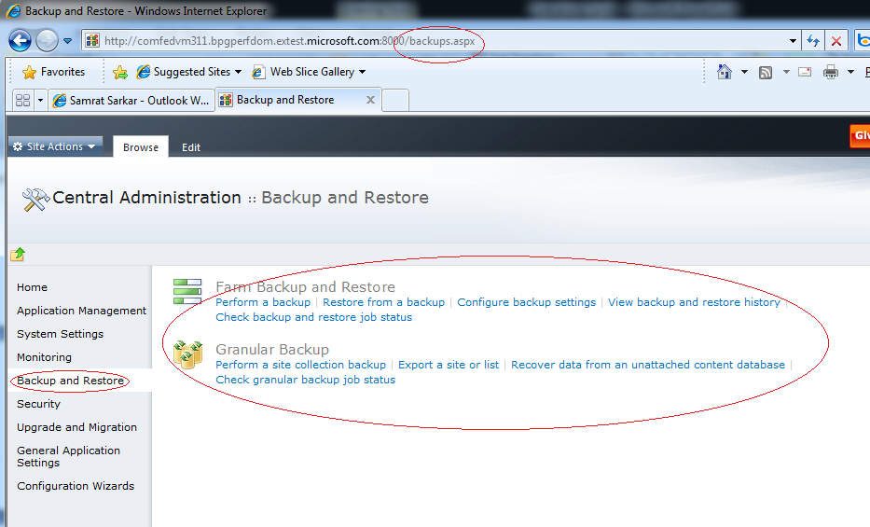
Backup/Restore UI
Notes:
UI = User Interface
You can see that the backup restore section has its own link on the left navigation of the central admin, and the corresponding links mentioned. The next few slides will show a few screen shots of those links

Slide 82
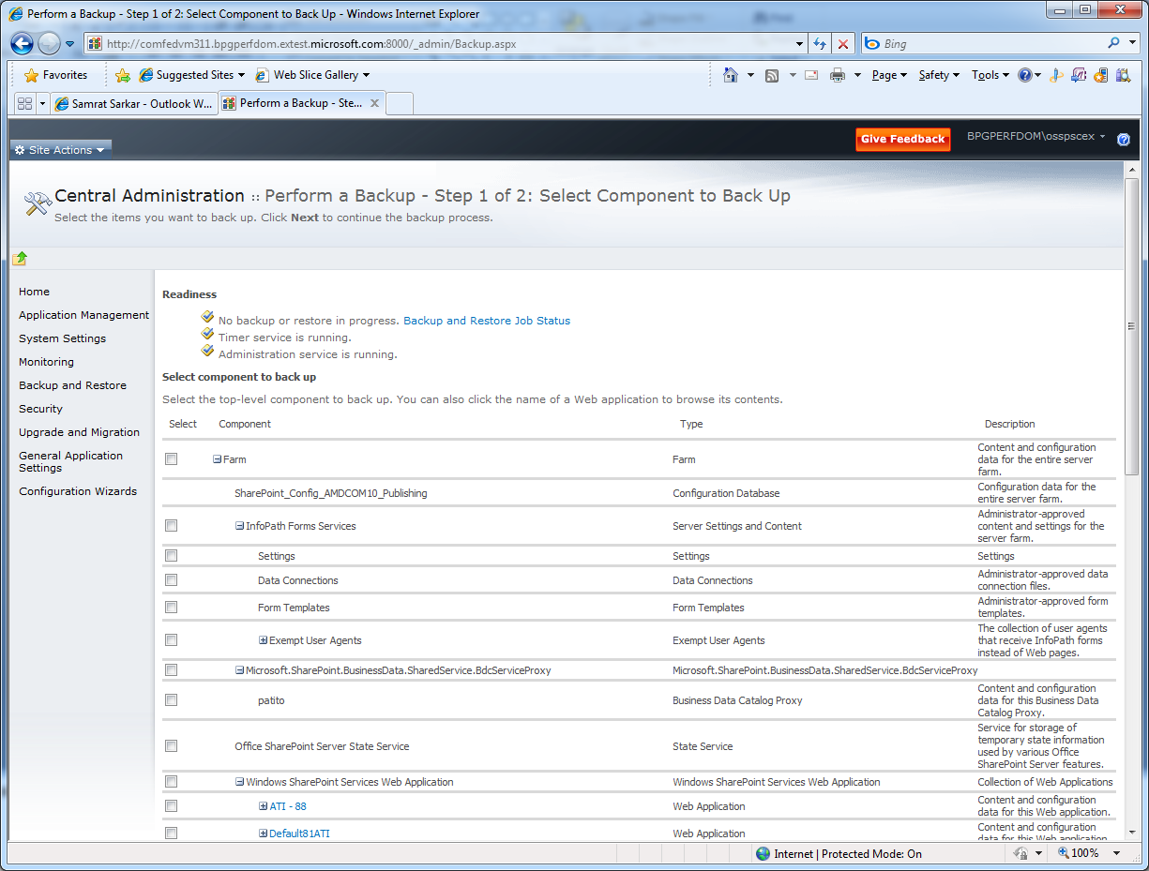
Farm Backup
Notes:
Backup entire farm (including config db)
Backup specific Service Applications
Backup all web applications
Backup specific web applications
Backup Proxy groups
Backup Managed Accounts

Slide 83
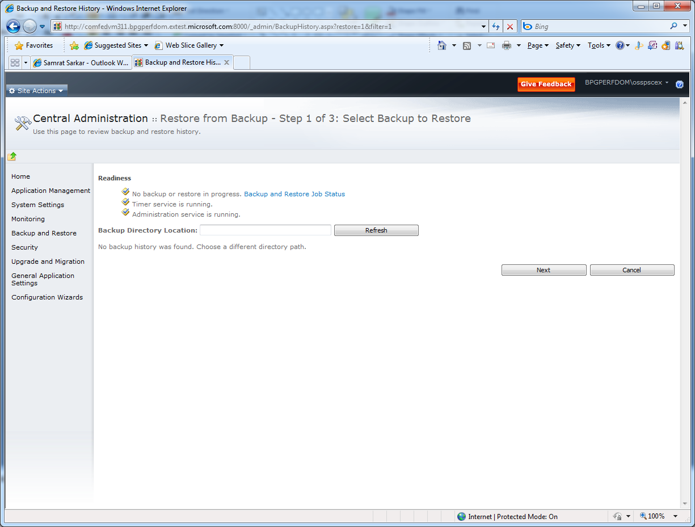
Farm Restore
Notes:
On this screen you can specify a backup location, and hit refresh here to show all the entities that you can restore. If you backed up the entire farm, you’d see the same granular controls you saw on the backup page to restore (ie restore whole farm, restore all web applications, restore Service Applications, restore Managed accounts, etc.

Slide 84
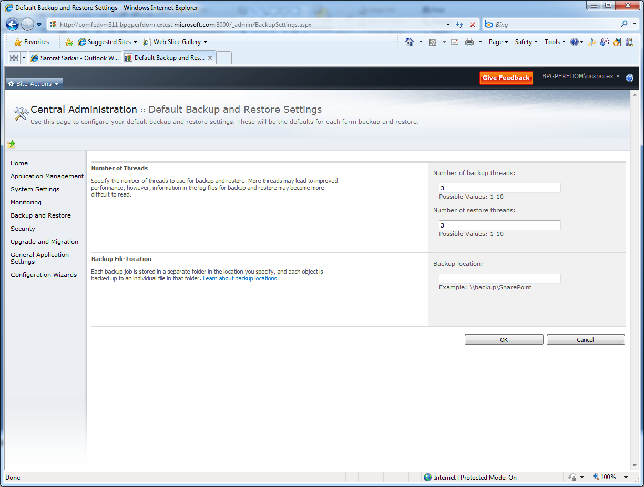
Backup and Restore Settings
Notes:
The number of threads used will affect the speed of the backup, but may also affect the performance of the rest of the farm depending on overall load.
Saving to a network location is recommended, but make sure that that location is password protected. If someone w/ a lower privileged account can get to it, she or he can spin up a farm and restore that content, making themselves farm and site collection administrator to see if they can find any confidential information or personally identifiable information (PII) , etc.

Slide 85
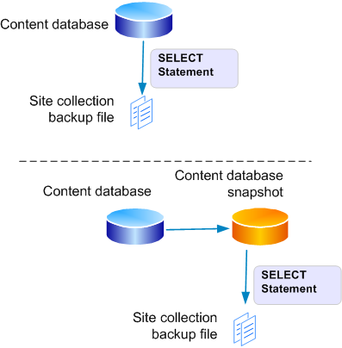
Site Collection Backup Process (with Snapshots)
Use SharePoint exports with SQL Select’s and writes to backup file
Optional (recommended):
PowerShell to take a snapshot
Export the site collection from the snapshot, and then delete the snapshot
Notes:
NOTE Site collection backup does not require the farm to be quiesced.
SharePoint exports the identified site collection by performing
one or two SQL SELECT statements to collect backup data, then writing data to file
Optional, but recommended. Use PowerShell to take a SQL Server
database snapshot, export the site collection from the snapshot,
and then delete the snapshot
A database snapshot provides a read-only, static view of a source database
as it existed at snapshot creation, minus any uncommitted transactions
Database snapshots are dependent on the source database.
The snapshots of a database must be on the same server instance
as the database
NOTE: Do not keep a snapshot longer than necessary – a snapshot impacts the performance of the live database, as it checks references against it

Slide 86
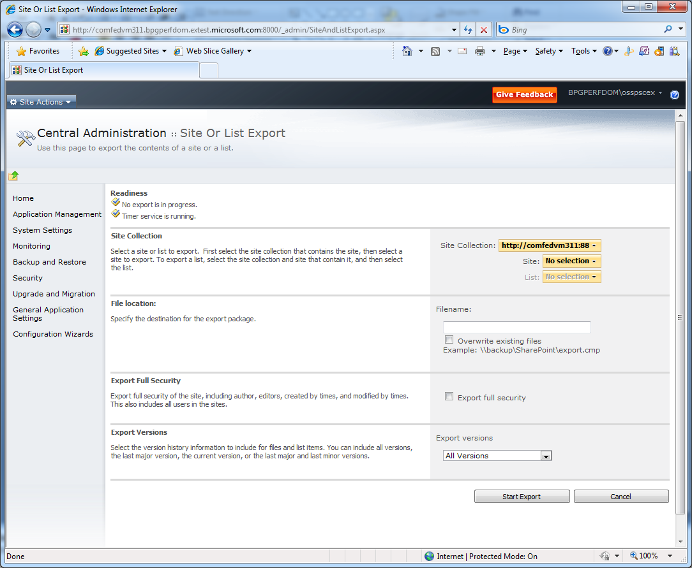
Export Site Collection
Notes:
This is the equivalent of “stsadm –o export”.
Most of the options available using stsadm are the available on this page, with the addition of the List export as well. No more trying to export a list as a template w/ content, being limited by 500 MB after first running another stsadm command.

Slide 87
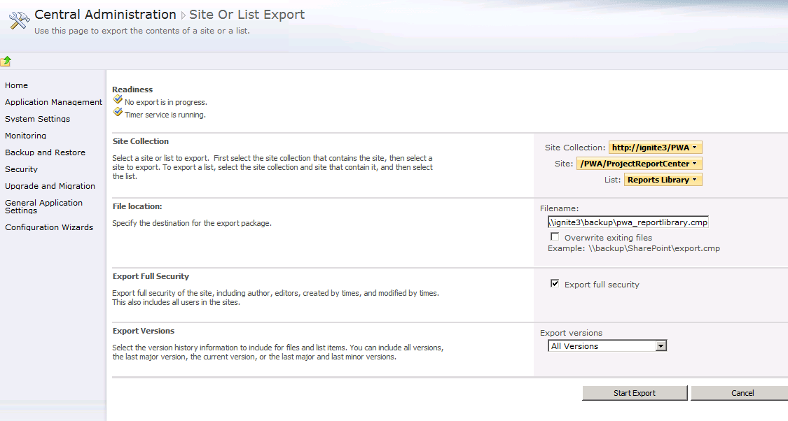
Granular Backup
Site Collections, Site(s), List(s)

Slide 88
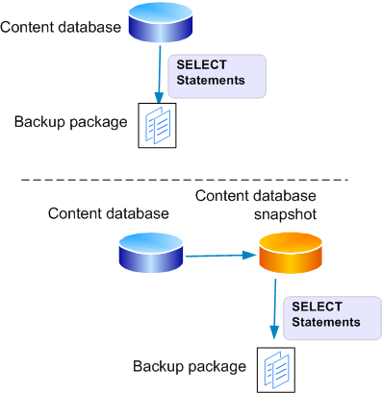
Site/List Restore Process (with Snapshots)
Select an unattached content database to connect to
In the unattached database, perform a site collection backup, or site or list export
Disconnect from the unattached database
Use PowerShell to restore the site collection, or import a site or list

Slide 89
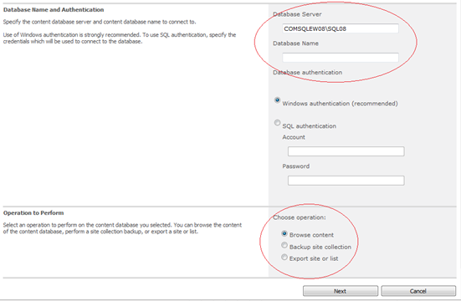
Recover from an Unattached Content DB
Notes:
In previous versions, if content was deleted, and you’d passed enough time, that the content was purged from the recycle bin, you’d have to:
Fire up another farm with a database backup, and locate that data.
Export the data from that farm to another location
Import from that location to the live/pre-production farm;
Verify that’s the correct data
Repeat to make it go live.
With Project Server 2010 you can restore that database into SQL but NOT even attach it to any server farm. From this UI you can traverse the content in that database and:
Browse the content
Export content
Backup a site collection

Slide 90
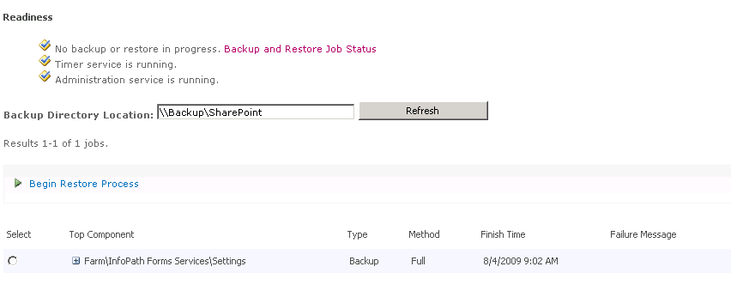
Backup History
Provides execution time, warning and error counts
Notes:
This page should be visited once scheduled backup completes to verify that it succeeded.

Slide 91
Configuration Settings
Will be possible to perform configuration-only backups from a farm and restore it to another farm
Not restricted to same machine anymore
Supports restore to new farm and/or new hardware
Notes:
Backing Up and Restoring Farm Configuration Settings
With Project Server 2010 , you can perform configuration-only backups on a primary farm and apply these settings to a secondary farm. This eliminates the need for the manual process of keeping the configuration databases on both farms in synch. Periodic configuration-only backups can be applied to keep the configuration settings and solutions in synch between two farms in high-availability deployments.
You can back up and restore farm configuration data that is not machine-specific. This allows most of the configuration settings on a farm to be restored to a new farm on new hardware or in a different physical location. The configuration data can be restored along with content. Or, the configuration data can be restored alone to create a second farm with the same settings as the original. This information can also be extracted from an existing SQL backup of the configuration database, in order to be compatible with a variety of backup solutions.

Slide 92
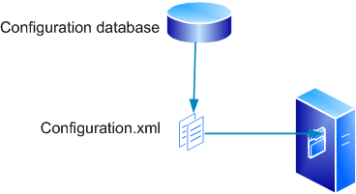
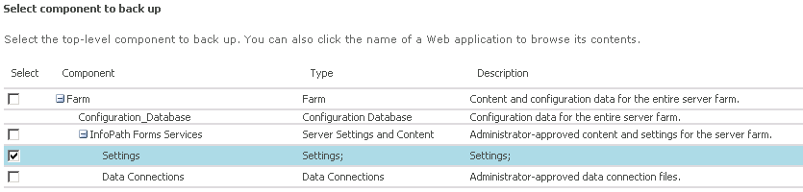
Configuration Settings Backup Process
The configuration settings are written to an xml file, and backed up with file server backup
Notes:
NOTE Configuration settings backup does not require the farm to be quiesced.

Slide 93
Configuration Backup Solutions
Method/ technology | Recoverable | Backup size supported | Backup type(s) supported
Systems Center Data Protection Manager 2007 | N
Microsoft SharePoint Server 2010 | Y | < 200 GB | Full, Differential
VSS Writer | Y | Limitation specific to solution implemented | Full, Differential
SQL Server | N

Slide 94
Content Recovery
Project Server 2010 can:
Restore site collection, site or list content to a previous version or point in time
Recover site collection, site, list content after deletion, without the need for a recovery farm

Slide 95
Read-only Content Databases
Attach a read-only content database to a farm, and allow users to view content within site collections
In high-availability scenarios, attach a log-shipped (read-only) content database to a secondary farm so that users can browse that location even before a failover has taken place

Slide 96
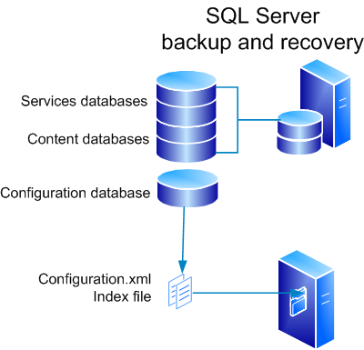
Farm Backup Process
SharePoint initiates a SQL backup of each service and content database
The configuration settings are written to an xml file, and backed up with file server backup
SharePoint initiates a SQL backup of the Search databases
Index and partition files are backed up in parallel
Master merge is paused to preserve index
Full database back up initiated
Full master index backup
Crawls are paused
Shadow indexes are backed up
Incremental database back up initiated
Crawls are resumed
Master merge is resumed
Notes:
NOTE Farm-level backup does not require the farm to be quieced.

Slide 97
Cross-Farm Backup/Restore (with same config settings)
Perform a full farm backup of SharePoint, and restore onto new hardware without losing configuration data
Restore configuration data onto a new SharePoint farm from an existing SQL backup of a configuration database
Back up and restore configuration data only, in order to create preproduction or secondary SharePoint farms with common configuration templates
Perform a point-in-time site collection or full farm backup, without hurting availability
Preserve database IDs and change log data while backing up, restoring and attaching content databases
Notes:
Instantiate a new farm with the same topology as the original farm
Execute PSConfig and reference the configuration.xml file from the farm you are recovering
Deploy customizations as required
Once you have started your farm, in Central Administration,
Activate any features, Perform a farm restore

Slide 98
Farm Backup Solutions
Method/ technology | Recoverable | Backup size supported | Backup type(s) supported
Systems Center Data Protection Manager 2007 | Y | 500 GB | Full, differential, incremental
Microsoft SharePoint Server 2010 | Y | < 200 GB | Full, differential
VSS Writer | Y | Limitation specific to solution implemented | Full, differential
SQL Server | N

Slide 99
Content Database Backup Solutions
Method/ technology | Recoverable | Backup size supported | Backup type(s) supported
Systems Center Data Protection Manager 2007 | Y | 500 GB | Full, differential, incremental
Microsoft SharePoint Server 2010 | Y | < 200 GB | Full, differential
VSS Writer | Y | Limitation specific to solution implemented | Full, differential
SQL Server | Y | Larger databases may require additional consideration | Full, differential

Slide 100
Service Application Backup Process
Service Applications with associated databases
SharePoint or SQL Server starts a SQL Server backup of each content database
Service Applications without associated databases
SharePoint starts a backup of the service

Slide 101
Service Application Restore Process
Stop the service
Detach the services database that you want to restore
Restore the services database as overwrite

Slide 102
Service Application Backup Solutions
Method/ technology | Recoverable | Backup size supported | Backup type(s) supported
Systems Center Data Protection Manager 2007 | Y | 500 GB | Full, differential, incremental
Microsoft SharePoint Server 2010 | Y | < 200 GB | Full, differential
VSS Writer | Y | Limitation specific to solution implemented | Full, differential
SQL Server | N

Slide 103
DataBase Mirroring

Slide 104
Database Mirroring All databases are now mirroring aware
Native support for SQL Server synchronous mirroring
Requires a principal, mirror, and witness server
Automatic mirroring failover is transparent to SharePoint and hence Project Server
Supports single database failover

Slide 105
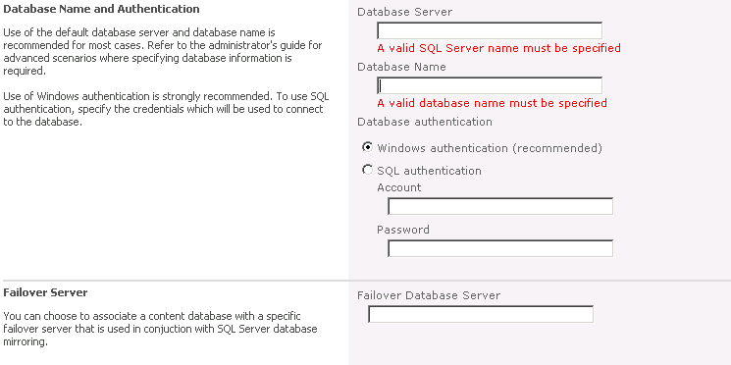
User Interface Support
Failover Database Server
Notes:
This screenshot shows to set the Database Mirroring failover database server using the Central Administration web site.
Central Administration UI entry points:
Web Application Service Content Databases
Secure Store Service
Search Service Administration
Windows SharePoint Services Search (Help Search)
Business Data Catalog
Managed Metadata Service
It is also possible to set this value using either PowerShell or the .Net programming model:
PowerShell Support
Get –SPWebApplication | Set SPFailoverDB -foo
----------------------------------------
Object Model Support (C#)
string failoverServer = ContentDatabaseSection.FailoverDatabaseServer;
SPDatabase db = GetDatabase();
db.AddFailoverServiceInstance(failoverServer);
db.Update();
or
SPDatabase db = GetDatabase();
db.FailoverServiceInstance = GetFailoverDatabaseServiceInstance();
db.Update();

Slide 106





Database Mirroring Mechanics
Web Server
Confirmation sent to client
4
Transaction submitted to mirror
Acknowledge message sent to principal
2
Principal SQL Server
Mirror SQL Server
3
Write transaction to log
Write transaction to database
Transaction completed on mirror
1
2
2

Slide 107
Database Mirroring Fail-over
Web server or Application server
SQL Server
Principal
SQL Server
Mirror
SQL Server
Witness
Notes:
Using SQL Server Transact-SQL to monitor database mirroring state:
USE master
GO
SELECT sys.databases.name 'Name', 'Status' =
CASE
WHEN sys.database_mirroring.mirroring_role = 1 THEN 'Principal'
WHEN sys.database_mirroring.mirroring_role = 2 THEN 'Mirror'
ELSE 'Not Mirrored'
END
FROM sys.databases, sys.database_mirroring
WHERE sys.databases.database_id = sys.database_mirroring.database_id
ORDER BY Status

Slide 108
Disaster Recovery between farms

Slide 109
Disaster Recovery Farm Improvements in 2010
Better support for log shipping
No need to detach/attach content databases in order to refresh the list of sites recognized by the configuration database
We can log ship to two target databases and have uninterrupted read-only access to the content at all times (we switch between databases during log processing)
Notes:
Available PowerShell command to refresh the list of sites recognized by the configuration DB
! Use PowerShell:
SPContentDatabase.RefreshSitesInConfigurationDatabase();

Slide 110




SQL Server Log Shipping Mechanics and background
1) Initial database backup
Primary SQL Server
Secondary SQL Servers
3) Back up transaction logs
2) Restore database with recovery
5) Restore transaction logs
4) Copy transaction log backup files
SQL Agent (xp_SqlMaint)
Transaction log backup files
Copied transaction log backup files

Slide 111
High Availability
Configure automatic database failover on a per-content database level, without using Microsoft® SQL Server® client aliases
Attach a read-only log-shipped content database to a secondary farm so that users can browse that location even before a failover has taken place
Propagate configuration changes to a secondary/failover farm without re-attaching the content database

Slide 112
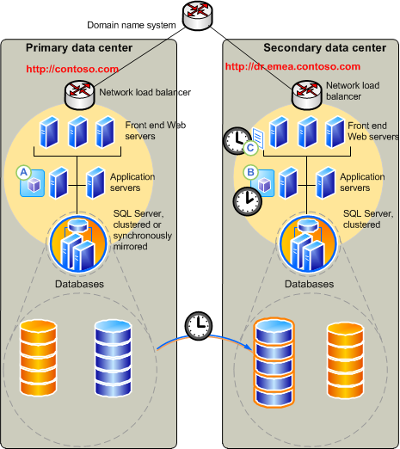
Disaster Recovery Farm Using Log Shipping
D/R
PWA
Primary PWA
Config, Services databases DB 1
Config, Services databases DB 2
Content Log Shipping

Slide 113

Disaster Recovery Farm Utilizing Logs Shipping

Slide 114
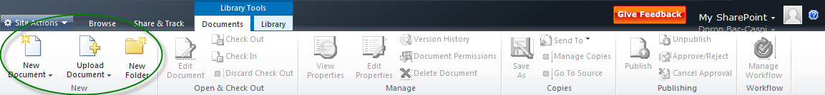
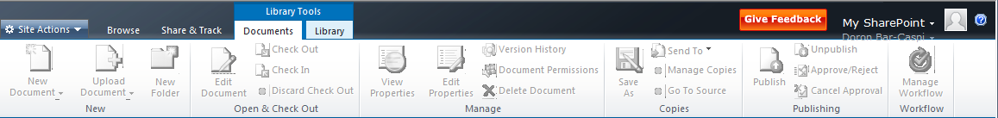
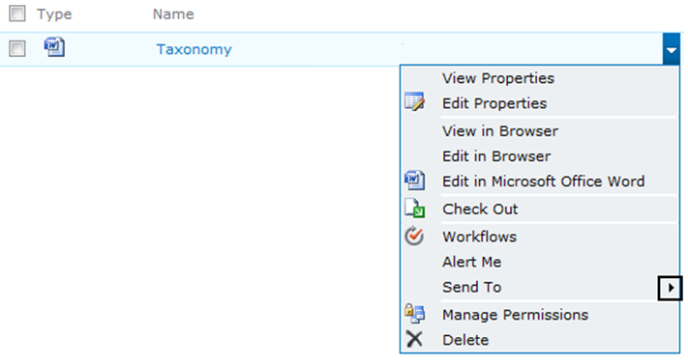
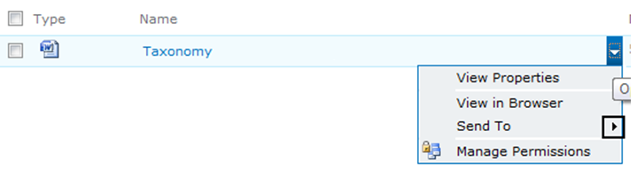
Disaster Recovery Farm What does a user see in a read-only farm?

Slide 115
Read-Only Mode
Read-only support provided for
Service Applications
Content databases
Service Applications
Implemented through applying a IsReadOnly flag on the Shared Service Application Layer
Granularity of Read-Only can span a Subscription (Partition) ID to allow for a multi-tenancy hosting environment perform maintenance on groups of users
Content databases
Implemented through setting the IsReadOnly SPDatabase property programmatically

Slide 116
Backup and Restore Recap

Slide 117
Backup and Restore Recap
We now support backing up configuration settings only
Former script-only capabilities now available in UI
Includes exploring a site for backup/export
Restore from an unattached database allows you to:
Restore from a snapshot
Restore without a dedicated restore farm
Backward compatibility allows restore without database upgrade
Test the integrity of the restore file without actually restoring

Slide 118
Recovery Scenarios
Backups can be performed to support many recovery scenarios. Common scenarios include:
Recreate a farm on new hardware, or in a different location, assuming that no parts of the original farm are available. (Disaster recovery)
Create a new farm based on an existing farm’s configuration and backups
Create backups to support highly-available farms
Archive versions of a site
Use unattached databases to recover site collections, sites or lists (documents possible with OM)

Slide 119
Backup/Recovery Tools
PowerShell
SharePoint Object Model
SQL Server® 2005 and SQL Server® 2008
Microsoft® Visual SourceSafe® backup tools

